Slide 1
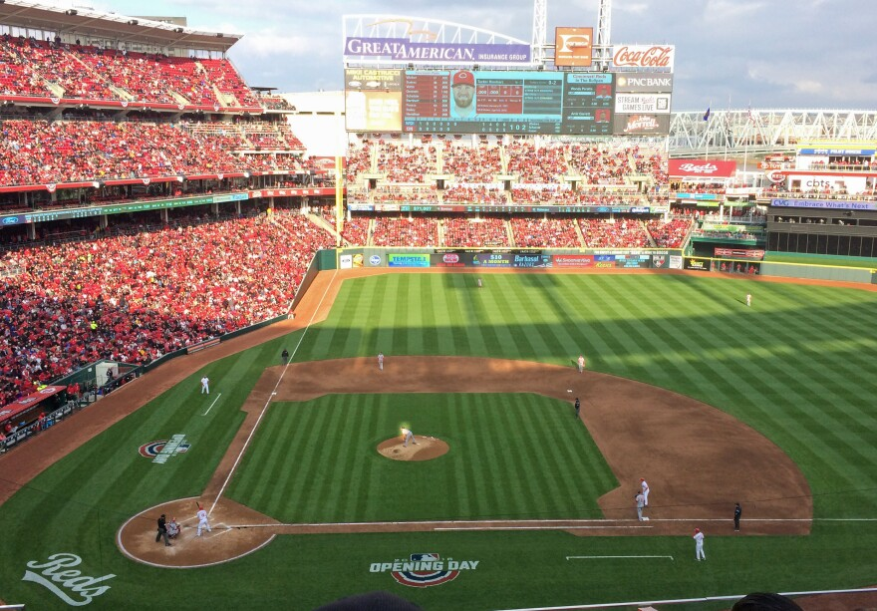


Nathan Backman, Jake Balek, Hunter Geise,
Danielle Napierski and Nolan Pittman
2024 Cincinnati Reds Hackathon: MLB's Freaky Friday Pitcher Role Reversal
X
Notes:
Nathan

Slide 2
Goal:
Identify different types of relief pitchers and analyze their impact in specific roles
Notes:
Nathan

Slide 3
Overview
Cluster relievers into roles
Plate Discipline tendencies
Observe success of each pitcher class in different roles
Cluster pitchers into classes
Classify pitchers using tendency clusters
Batted Ball tendencies
Determine which pitchers are being used “incorrectly”
Suggest new roles for these pitchers
Notes:
Nathan
Unsupervised learning

Slide 4


Data
Fangraphs Season Level
Savant Pitch Level
Notes:
Nolan
For our data we decided to only utilize the fangraphs season level and Savant pitch level data that were given to us by the Reds. From this data, however, we added in our own variables that we thought would be relevant to our analysis on both the season and pitch levels.
For the batted ball clusters, we decided to use more of the Statcast metrics as our predictors, including aggregated statistics like how hard or where balls were hit. For the plate discipline clusters, we focused more on metrics from the fangraphs data like K%.
Data manipulation:
Added our own metrics that would be relevant to analysis (shadow zone pct, IRISP pct, Fresh inning pct, BF per appearance). Shadow_zone calculated with strike zone measurements as defined by Statcast
Aggregated certain metrics from Statcast pitch level data (GB/FB/LD/PU%, Batted ball types%)
Aggregated Statcast metrics for batted ball cluster model (type of hit, hard/med/weak, oppo/pull)
Fangraphs for plate discipline cluster model (K%, BB%, Whiff%)

Slide 5
Research Methodology
Agglomerative Hierarchical Clustering Model
Filtered down to a minimum of 50 total batters faced
Data converted to percentiles
Clusters created for each of the following:
Batted Ball
Pitcher’s tendency to allow different types of contact
Plate Discipline
Pitcher’s ability to control the zone
Reliever Role
Situation pitcher is given when they enter a game
Notes:
Nolan
Now looking at our methodology we decided to use agglomerative hierarchical clustering which is a bottom-up clustering method that initially sees each observation as a cluster, merging the two most similar pairs of clusters together until each observation is accounted for and only one giant cluster remains.
The algorithm relies on two inputs, the similarity measure and the linkage criteria. We chose to use euclidean distance (straight line distance) as our similarity measure and Ward’s method (compute sum of squared differences within all clusters that would result from merging two clusters. merge the two clusters that would result in the smallest increase in total within-cluster variance) as our linkage criteria.
To ensure the integrity of the clusters and prevent skewness, we filtered the data to include only pitchers who had at least 50 total batters faced. Additionally, we transformed all predictor variables into percentiles, primarily due to their non-normal distribution, which facilitated better cluster conversions.
We applied this methodology to three cluster models, batted ball, plate discipline, and reliever roles. To optimize the clusters for each model, we used silhouette score and gap stat methods and took the consensus ideal number of clusters.

Slide 6
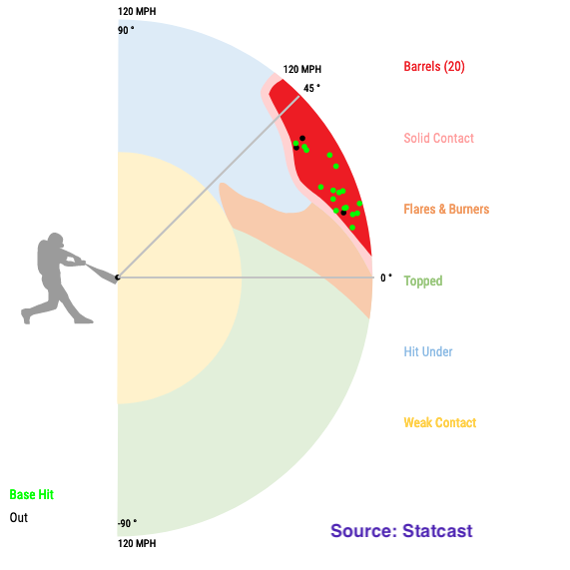
Batted Ball
Cluster Model
Variables Used:
Weak Contact%
Hit Under%
Topped%
Flare/Burner%
Solid Contact%
Barrel%
Ground Ball%
Fly Ball%
Line Drive%
Pop Up%
Notes:
Danielle
all these variables aggregated from savant pitch level data set
Where pitchers tend to get batters to hit the ball on the field
We also account for the result of the at bat because that has an effect on the game situation

Slide 7
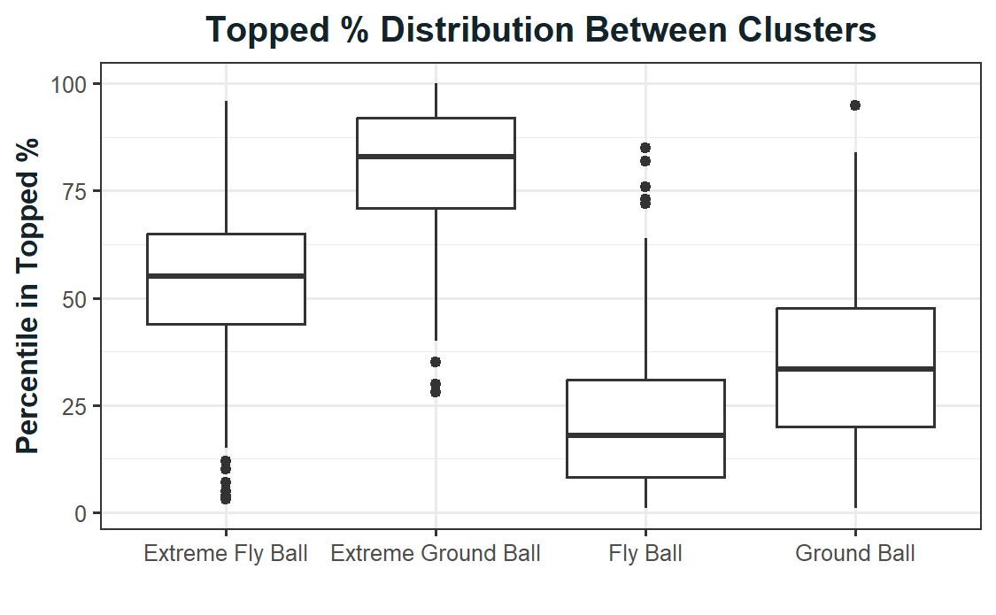
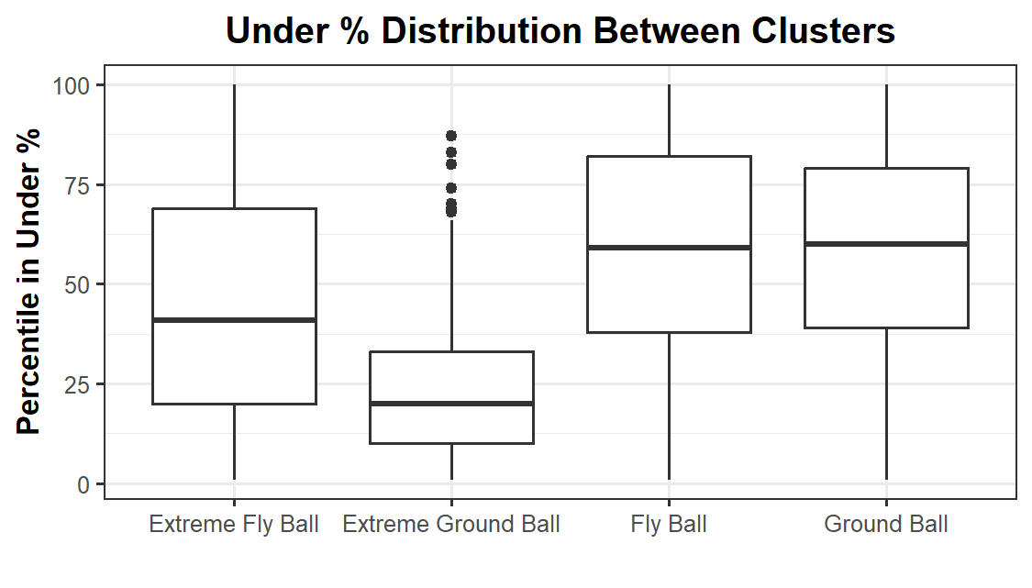
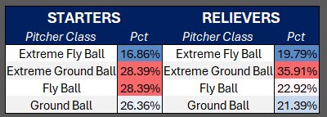
Batted Ball Model Clusters
Final Clusters
Extreme Fly Ball
Extreme Ground Ball
Fly Ball
Ground Ball
Fly Ball
Extreme Fly Ball
Fly Ball
Extreme Fly Ball
Notes:
Danielle
Note: Ground Ball and Fly Ball clusters lean more towards a “neutral” class, but lean slightly in towards one direction
final clusters are pitchers that as extreme fly ball, extreme ground ball, fly ball, ground ball
From the topped % box plots, we can see that extreme gb pitchers tend to have a higher topped % which makes sense because they get the pitches under the bat
same with fly ball pitchers and having a high under %, because that is what leads to fly balls and popups
Relatively uniform distribution among the pitcher classes as we see in the table
The model was trained on both starters and relievers to get the archetype

Slide 8
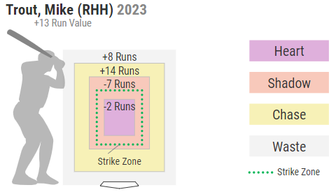
Plate Discipline Cluster Model
Variables Used:
Strikeout%
Walk%
Chase%
Zone Swing%
Chase Contact%
Zone Contact%
Swing%
Zone%
Shadow Zone%
First Pitch Strike%
Whiff%
Swinging Strike%
Called Strike%
Notes:
Hunter
Variables chosen show how pitchers get outs
Aggregated shadow zone from statcast pitch level data
Model was trained on starting and relief pitchers to get the archetype
All other variables were from fangraphs
Picture on the right shows statcasts definition of shadow zone

Slide 9
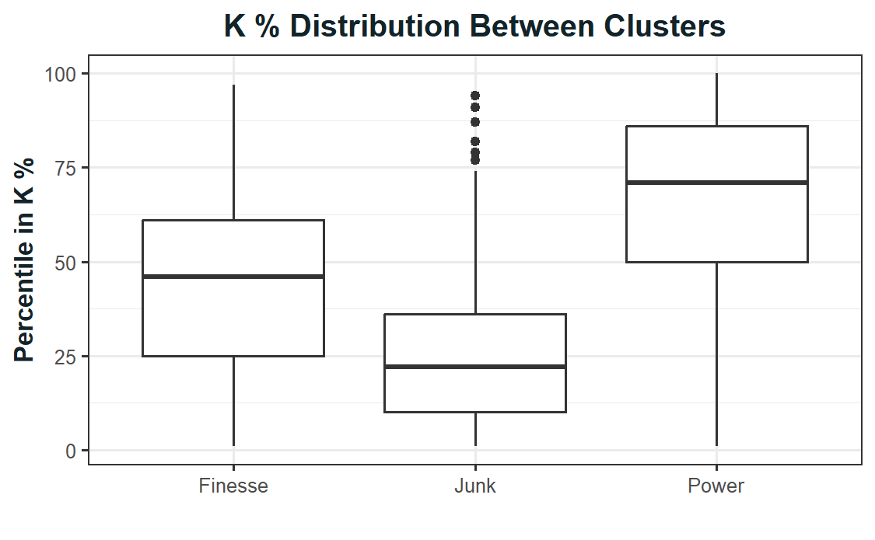
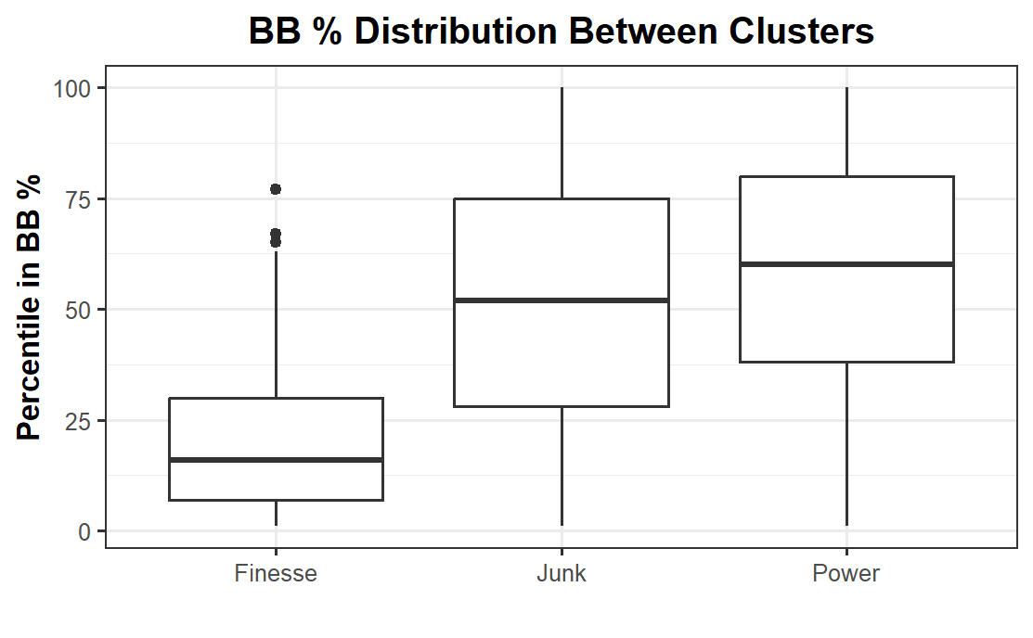
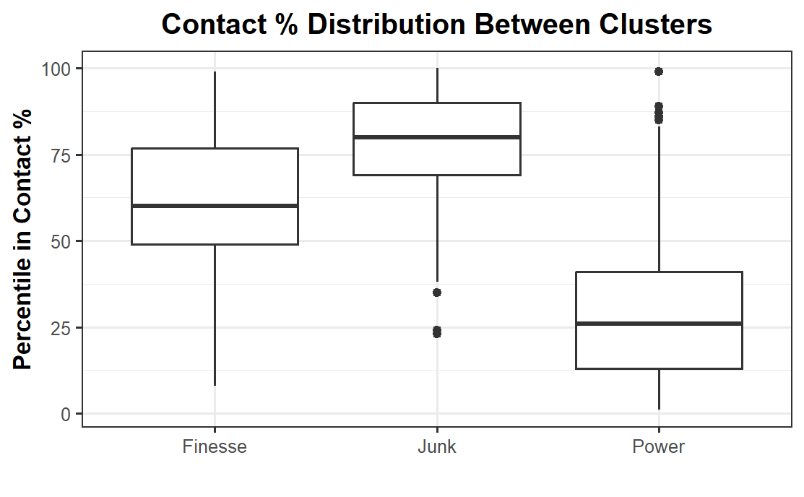
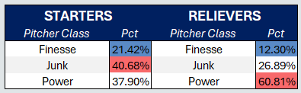
Plate Discipline Model Clusters
Final Clusters
Power
Junk
Finesse
Notes:
Hunter
What the boxplot shows:
Finesse and power pitchers have ways of striking batters out (power pitchers with swing and miss, finesse with called strikes); junk pitchers are those that tend not to strike batters out
Didn’t reverse walk scale - lower walk percentile equates to lower walk percentage
Finesse pitchers not as prevalent, high amount of power in relievers, junk more likely to be in starter role

Slide 10
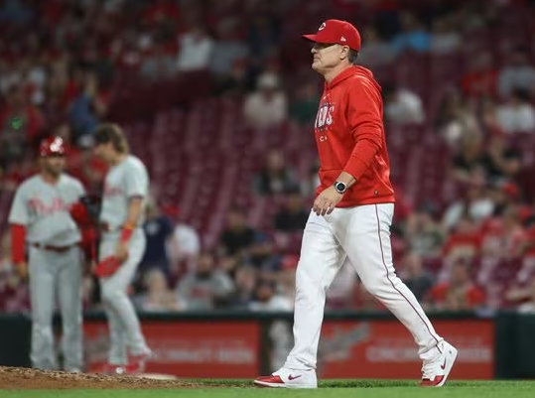
Reliever Role Cluster Model
Variables Used:
Entrance Leverage Index
% Time Entering the Game with RISP
% Time Entering the Game with No One On and No Outs
# of Batters Faced per Appearance
Notes:
Jake
This model ties both of the previous 2 together as it is the most important. It determines different roles in which a relief pitcher comes into the game most often.
The purpose of this model was to determine which pitchers were having success in certain roles and which pitchers may have success in another role based on the rest of the league and whether or not a certain archetype of pitcher is doing well in a role.
As you can see our variables on the right, we looked at the leverage index related to the pitcher entering the game. We also looked at pct of time entering the game with RISP, pct of time entering the game with no runners on and no outs.
Our final variable simply consisted of the number of batters a pitcher faced per appearance.

Slide 11
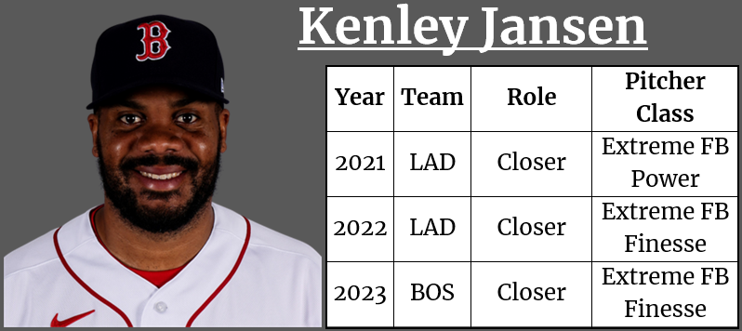
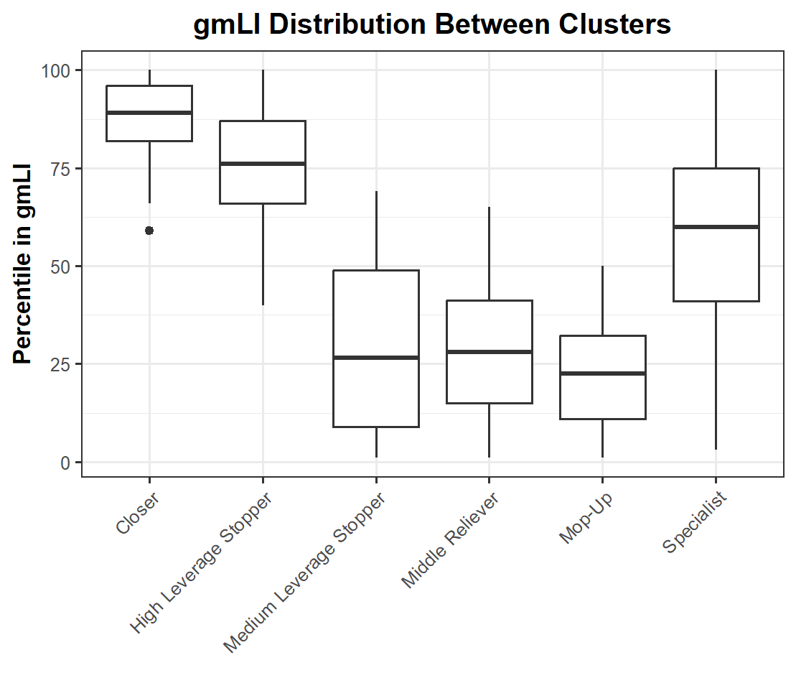
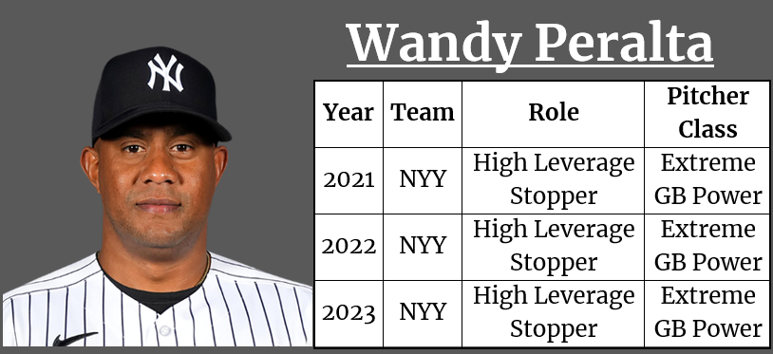
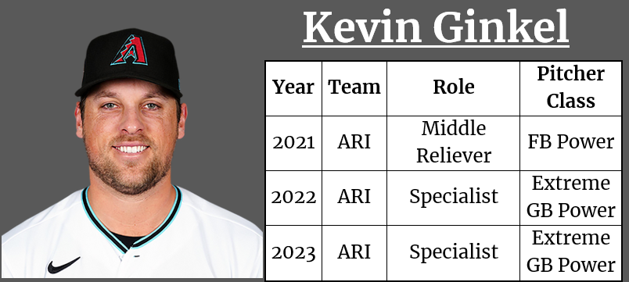
Reliever Role Results
Final Clusters
Notes:
Jake
Our model grouped pitchers into 6 clusters or relief roles that make of up most of the MLB bullpens.
You can see some examples of players on the right and the roles that they have played the past 3 years. Our roles described consist of:
Closer: typical pitcher that comes in while team is up with a fresh 9th inning
High Leverage Stopper: typically gets put in the game with inherited runners late in a close game
Medium Leverage Stopper: typically gets put in the game with inherited runners in a close game in middle innings
Middle Relief: typically a “setup” man; someone who gets put into the game in a middle inning with a fresh inning and might be asked to go more than one inning
Mop-Up: typically the “long relief” pitcher; comes into the game earlier and faces the most amount of batters
Specialist: no clear definition of this role based on our model inputs; interpreted as someone who comes into the game because of a specific matchup

Slide 12
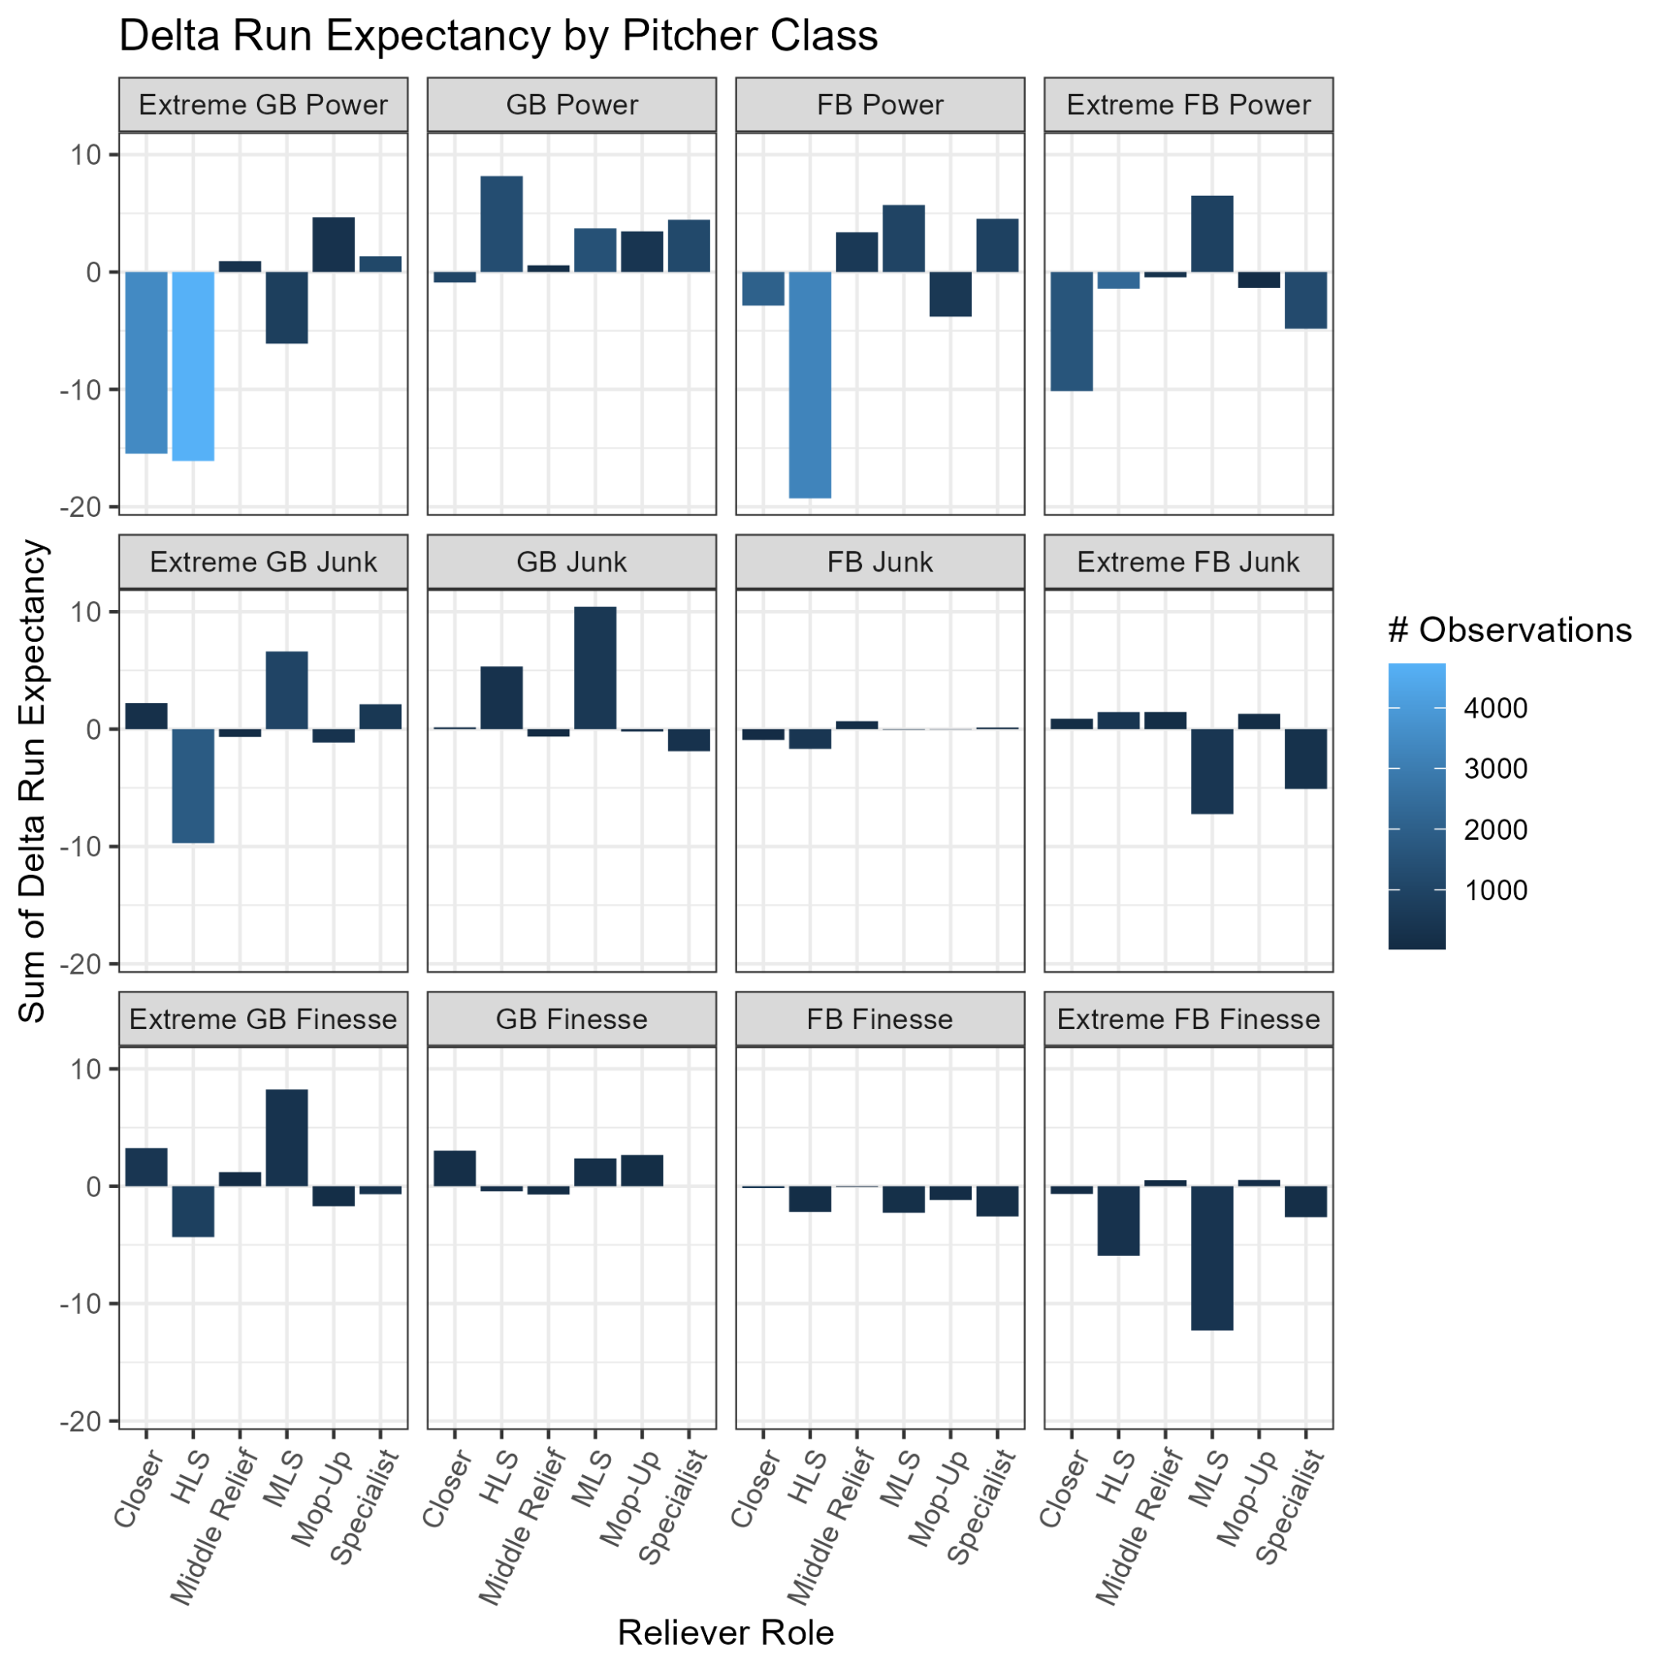
Success of Each Class in Different Roles
Power pitchers are more effective in high leverage roles
Extreme GB pitchers are more effective in the High Leverage Stopper role
Notes:
Jake
After running the model, we wanted to visualize correlations between each of the roles that certain pitchers may be in the MLB. It is important to note that we only looked at the first at bat when a pitcher entered the game relating to the sum of delta runs expectancy.
The graphic shows the sum of change in run expectancy by pitcher. Intuition makes sense here as you can see in the top left extreme groundball power pitchers tend to have success in the closer and high leverage roles. Same goes for the 2 examples on the bullet points to the left.
Overall, the model was successful in predicting roles of different pitchers across the league which allowed us to then figure out which pitchers may benefit from a role change and move from a high change in run expectancy to a role with lower run expectancy relating to their pitcher archetype.

Slide 13
Reliever Role Hierarchy
Closer
High Leverage
Medium Leverage
Middle Relief
Specialist
Mop-Up
Notes:
Nathan
Reliever role cluster hierarchy

Slide 14
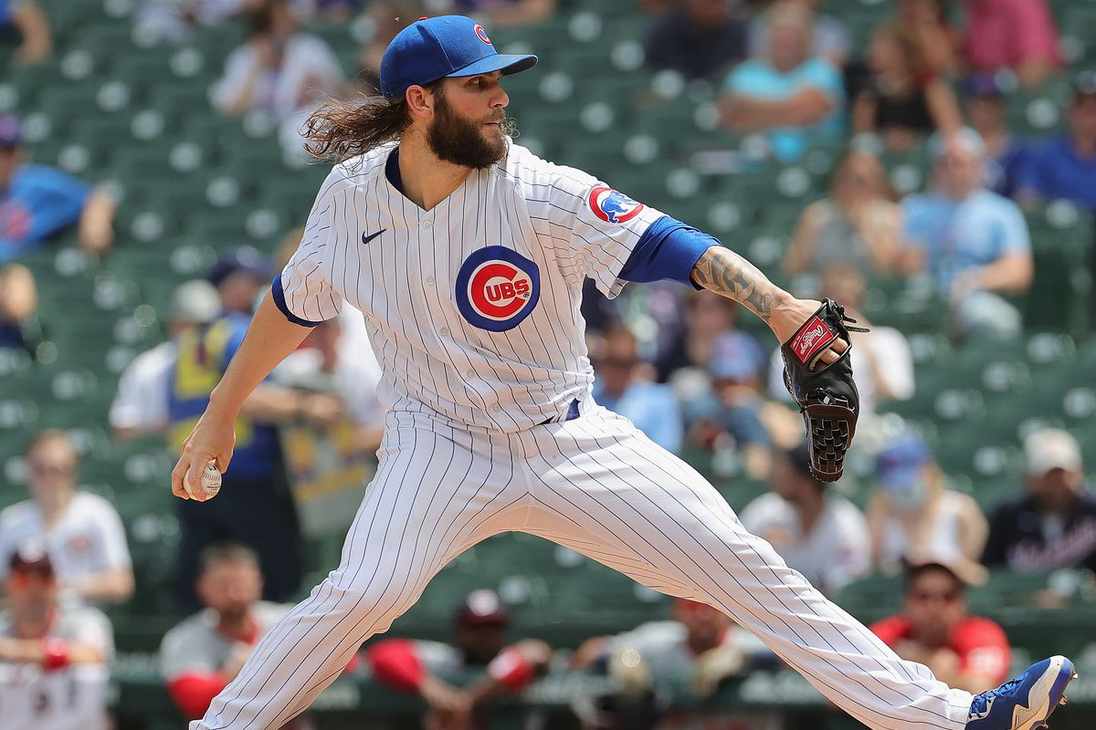

Trevor Williams
2021 Class: Extreme GB Finesse
2022 Class: GB Finesse
4.53 ERA, -0.2 bWAR w/ Cubs in 2021
-0.317 DRE as Mop-Up w/ Cubs
+0.924 DRE as Mop-Up w/ Mets
-0.179 DRE in “stopper” situations w/ Mets
2.71 ERA, 0.5 bWAR w/ Mets in 2021
3.88 ERA, 1.4 bWAR w/ Mets in 2022
Mop-Up
Medium Leverage
Notes:
Nathan
GB Finesse pitchers performed marginally better by DRE in the medium leverage stopper role according to the data
“Stopper” situations were classified as entering the game with one or more runners on

Slide 15
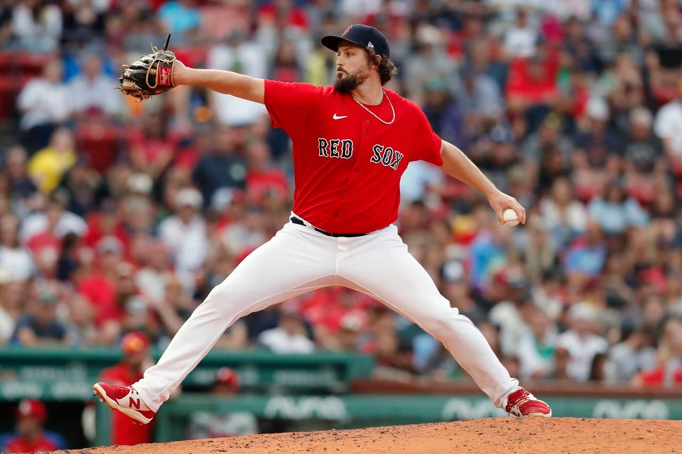
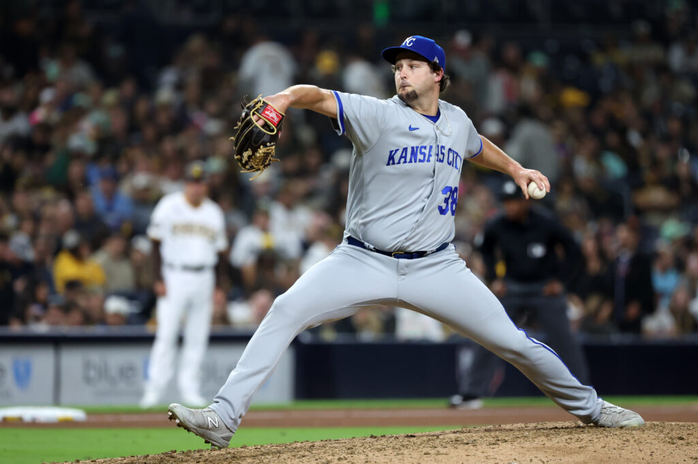
Josh Taylor
2023 Class: Extreme GB Power
+0.158 DRE in Mop-Up w/ Royals in 2023
8.15 ERA and -0.5 bWAR
Mop-Up Extreme GB Power: +4.664 DRE
Specialist Extreme GB Power: +1.340 DRE
Mop-Up
Specialist
Notes:
Jake
Josh Taylor was most recently in the Mop-Up role with the Royals bullpen in 2023. While it may have been due to him coming off a big injury, Taylor struggled mightily in the Mop-Up role, with majority of his appearances coming in “fresh” innings. We believe Taylor would see more success in a specialist role, where he would have less pressure to get more outs and rather focus on that particular matchup. As you can see in the top right, Mop-Up roles with the same pitcher archetype had a delta run expectancy of 4.664 while specialists with the same archetype had a lower delta runs expectancy of 1.340.

Slide 16
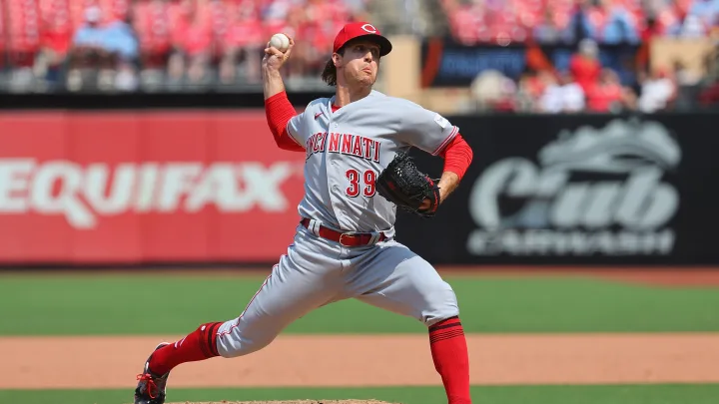

Lucas Sims
2023 Class: Extreme FB Power
+4.747 DRE as HLS w/ Reds in 2023
3.10 ERA and 1.8 bWAR
12 Meltdowns
+4.382 DRE in “stopper” situations
MR Extreme FB Power: -4.831 DRE
High Leverage
Middle Relief
Notes:
Nolan
The last reliever we decided to look at was Lucas Sims from the Reds. We categorized Sims reliever role as a high leverage reliever in the 2023 season where on the surface he looked fine with a 3.10 era and 1.8 bWAR, but analytically faltered with a +4.7 change in run expectancy and 12 meltdowns.
Although his archetype’s (Extreme Fly Ball Power) success in the high leverage role is very good, we believe Sims needs to be put in less “stopper” scenarios; therefore we would recommend a move to the Middle Relief role, where he will have less entrances with inherited runners.
He’s proven he can pitch in higher leverage, but he may be better suited for that setup/potentially even closer role, although that role appears to be secured by Alexis Diaz

Slide 17
Shortcomings
Black box approach
Analysis was only on relievers
Impact of relievers only accounted for first at bat
Delta Run Expectancy as our analysis metric
New role suggestions assume consistent pitcher class
Notes:
Nathan
clusters were far from perfect and can definitely be improved
analysis could be expanded to starters
Arbitrary measure for batters faced filter set at 50 (cronbach’s alpha)

Slide 18
Thank You for Your Time
Questions?

